Slide 1



Grand Canyon Council
2020 Fall Sale Updates
*Join us on Facebook*
Grand Canyon Council
Fundraising Forum

Slide 2

GCC 2019 Popcorn Sales
$1,360,024
Increase of $60,886
Growth over 2018 – 4.7%
Congrats!

Slide 3
Top Selling Scouts 2019
#20
Thru
#11

Slide 4
Top Selling Scouts 2019
#10
Thru
#6
Notes:
Duplicate this slide for every Unit. Please work with the Council staff to include a personal note about each person in these notes.

Slide 5
Top Selling Scouts 2019
#5
Thru
#2
Notes:
Duplicate this slide for every Unit. Please work with the Council staff to include a personal note about each person in these notes.

Slide 6
Top Selling Scouts 2019
#1
Selling Scout
Notes:
Duplicate this slide for every Unit. Please work with the Council staff to include a personal note about each person in these notes.

Slide 7
GCC Top Selling Units 2019
$20K
Club
#12, 18, 19 in the Nation!
Congrats Pack 536 & Troops 824 & 577
Notes:
Duplicate this slide for every Unit. Please work with the Council staff to include a personal note about each person in these notes.

Slide 8
Your District Kernels
Central: open
Gila: Misti Nichols – (602)423-4905
Lost Dutchman: Terri Farrington – (480)797-9246
Pinnacle Peak: Heather Babcock – (480)643-0337
Ponderosa: Amy Fredrick – (928)522-5822
Sonoran Sunset: Paul Stithem – (602)885-5438
Notes:
Duplicate this slide for every Unit. Please work with the Council staff to include a personal note about each person in these notes.

Slide 9
Register Your Unit
Register your Unit via this link
www.trails-end.com/unit-registration
Register for a webinar via this link
www.trails-end.com/webinars
Notes:
Duplicate this slide for every Unit. Please work with the Council staff to include a personal note about each person in these notes.

Slide 10

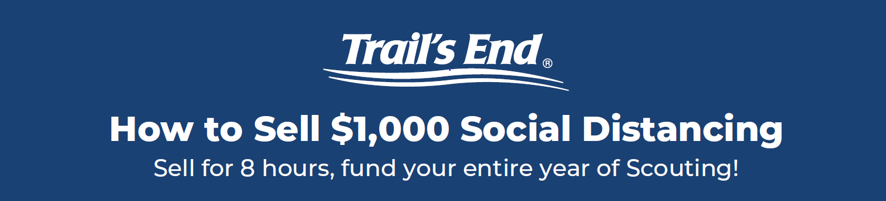
Trail’s End Programs
Can your Scouts sell safely?
How do we keep them safe?
Notes:
Change CTA to SMS

Slide 11


Slide 12
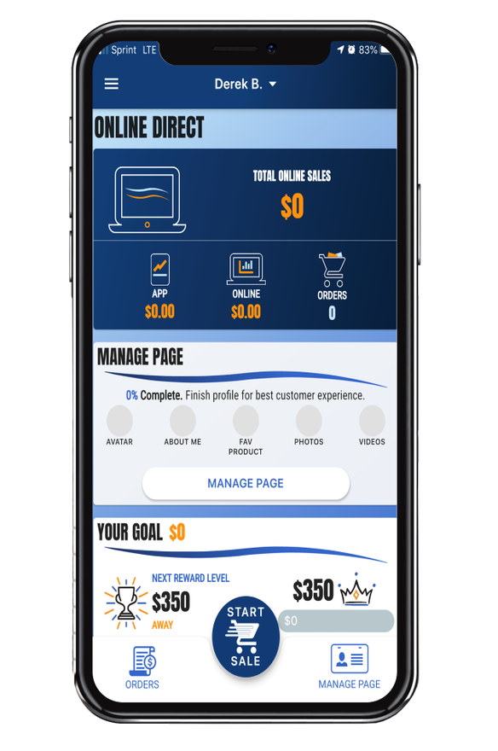
ONLINE DIRECT
    Safe way for Scouts to sell
    Scouts earn ‘More Points’ towards TE Rewards
    Traditional products and prices
      $10 opening price point
      Shipping: $7.99 1st item / $.99 per additional item
    No handling of products/cash for Scout or unit
    New TE App Online Direct features:
      Take Online Direct orders in the TE App
      Text order to customer to complete purchase on their phone
Text MYPLAN to 62771 to download:
How to Sell $1,000 Social Distancing

Slide 13
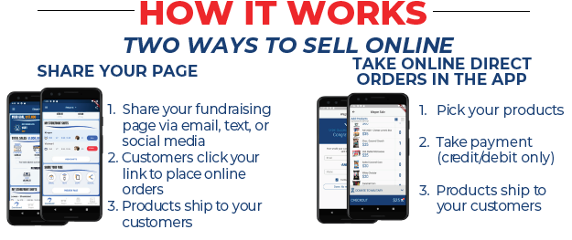
Online Direct

Slide 14
Start Selling Early
Trail’s End Online Direct unit promotion:
  Earn 5% of Online Direct sales in an Amazon.com gift card – Jul 1-Aug 15.
    Unit must be registered by August 15, 2020 to qualify.
  Look for other Promotions throughout the months of July and August!
Scout Online Direct Entrepreneur Challenge
  The 1st 200 Scouts sell $2,500 or more through Online Direct from July 1 – August 15 will receive a $200 Amazon.com Gift Card. www.trails-end.com/online-direct
Scouts can do ‘Take Order / Pre-Sales’ in July & August
  Sell in the App – take credit cards and earn ‘More Points’ towards your TE Rewards.
  Product to Units in September for pre-sales delivery.

Slide 15
Trail’s End Programs
Can my Scouts still sell using the Traditional Methods?
(Storefront / Door to Door)
Yes!
Notes:
Change CTA to SMS

Slide 16
Trail’s End App
  Improvements Based Upon Leader Feedback
  Faster…easier…simpler…time saver
  Rebuilt in Google Flutter.
  Faster Scout registration; Takes less than 1 minute.
  Checkout … 9 clicks to 4 by streamlining and eliminating extra steps.
  New Online Direct in TE App.
    Sell face-to-face, swipe a card, ship online products directly to consumer.
  Consolidated Scout and storefront views, reporting and actions.
    Fewer clicks to find information and take action.
    Simpler inventory views by storefront and by Scout.
  Re-associate storefront orders between shifts for easier managing sale.
New enhancements are LIVE! Current App version 2.2.9

Slide 17
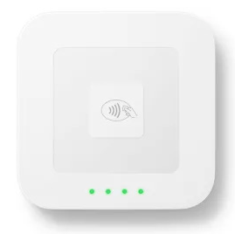


Accepting Credit/Debit
CREDIT SALES ARE BEST FOR SCOUTS
TELL YOUR CUSTOMERS, “WE PREFER CREDIT/DEBIT”
It’s safer!
Trail’s End pays for all credit card fees!
Bigger Rewards – Earn ‘More Points’ for credit card sales in the Trail’s End App
Safer – Scouts don’t have to handle cash
Higher Sales – Customers spent 27% more with credit vs. cash in 2019
Hardware – Scouts can accept credit/debit with Square readers or manual entry

Slide 18
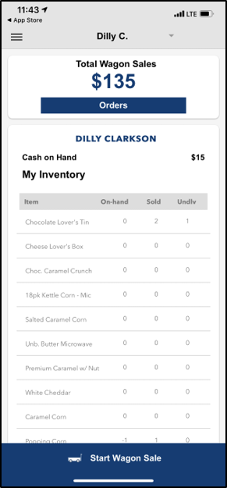
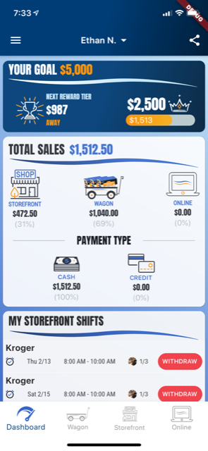
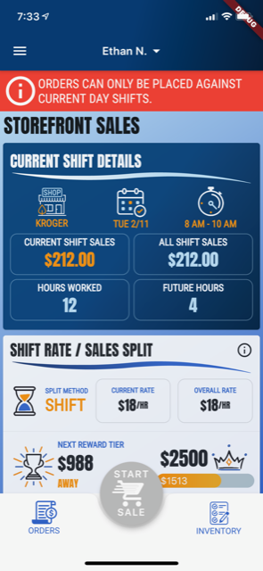
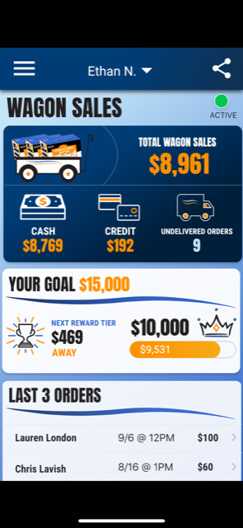
Trail’s End App
2019
2020

Slide 19
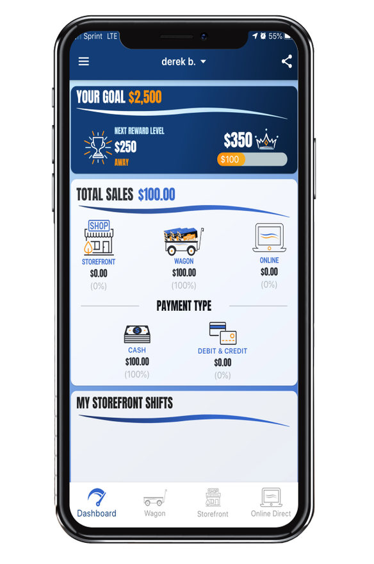
TRAIL’S END APP
Key Benefits
Free Credit Card Processing - Paid by Trail's End
Real-time tracking and reporting of sales, inventory and storefront registrations
Families can turn in cash payments via credit card
System-calculated Scout sales for easy Trail's End Rewards ordering
Take Online Direct orders in the app as way to fundraise while social distancing
Proven Results
Used by over 14,500 units & 160,000 Scouts
Over 10% growth for units that recorded more than 75% of sales in the app in 2019​
Credit Card transactions averaged 27% higher than cash
Text APP to 62771 to download.

Slide 20

TRAIL’S END APP

Slide 21

REGISTER YOUR UNIT!

Slide 22
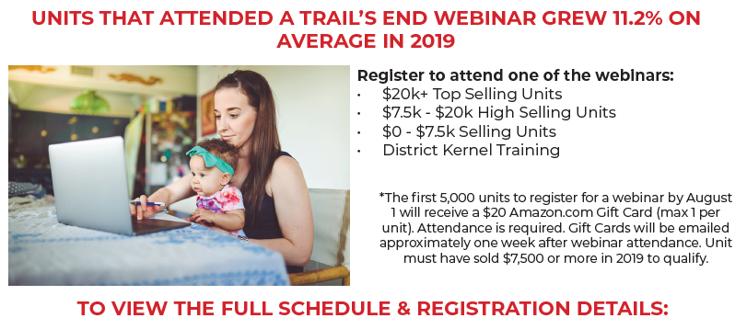
TRAIL’S END WEBINARS
  Every Question Asked…Every Question Answered!
Text WEBINAR to 62771 to Register!

Slide 23

TRAIL’S END FACEBOOK
Text FACEBOOK to 62771 to join!

Slide 24

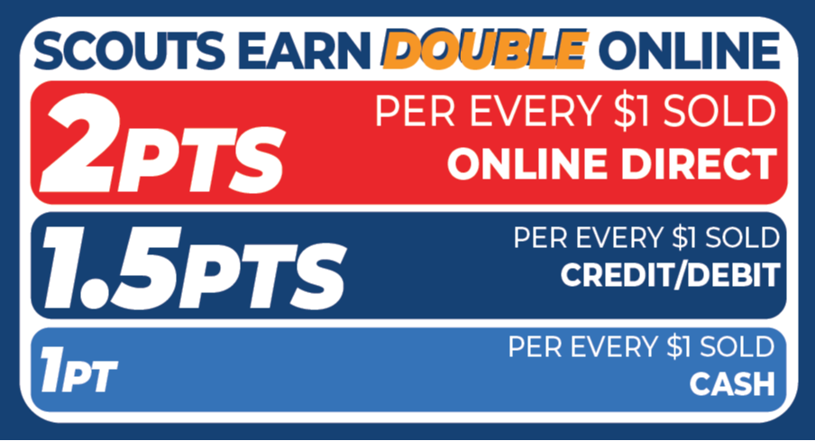
TRAIL’S END REWARDS
New in 2020
Points based Rewards system encouraging Scouts to sell more with Online Direct and with credit cards
With changes to the way they sell, Scouts can earn more Rewards faster!

Slide 25
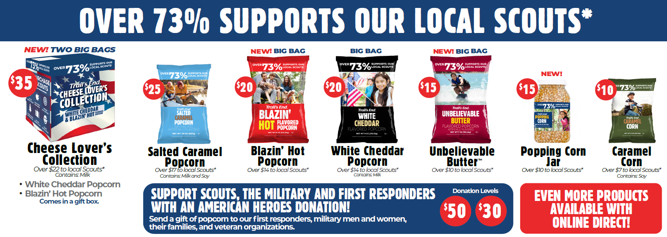
Traditional Products

Slide 26

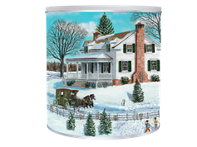

ONLINE EXCLUSIVES
(2) Dark Chocolate Salted caramels
(1) Chocolatey Caramel Crunch
Chocolatey Caramel Crunch
Unbelievable Butter (12pk)

Slide 27
TRAIL’S END READERS PROMOTION
Square Readers for Scouts – redeemed in the Trail’s End App beginning July 1:
Scouts who sold $1,000 - $3,499 in 2019 will receive a Square reader (headphone or lightning)
Scouts who sold $3,500+ in 2019 will receive a contactless Bluetooth reader

Slide 28
COMMISSION & KEY DATES
Commission for 2020
35% on ALL sales!
Key Dates for 2020
Storefront Signups Open – August 17 @ 10a
1st Order Date – Unit Orders Due Monday August 31st
1st Order Delivery Date – Saturday September 17th & 18th
Additional order dates - on Sept 21, Oct 5, and Nov 2

Slide 29
COUNCIL INCENTIVE
$1500 SALES LEVEL
$125 Voucher Summer camp
or
$100 Scout Shop gift card
*Vouchers for 2020 summer camp may be used in 2021 and combined with this year’s voucher*

Slide 30
EXAMPLE EARNINGS
$500 SALES - $175 comm, $25 early bonus = 40%
$1500 Sales - $525 comm, $75 early bonus, $125 camp credit = 48%
$2000 Sales - $875 comm, $125 early bonus, $125 camp credit = 45%
Plus estimated prize level (will vary depending on points earned/transaction type)
$500 Sales – 600 pts $20 (44%), 800 pts $30 (46% ), 1000 pts $40 (48%)
$1500 Sales – 2000 pts $80 (53%), 2500 pts $100 (55%), 3000 pts $200 (61%)
$2000 Sales – 3000 pts $200 (66%), 3500 pts $250 (69%), 4000 pts $300 (71%)

Slide 31
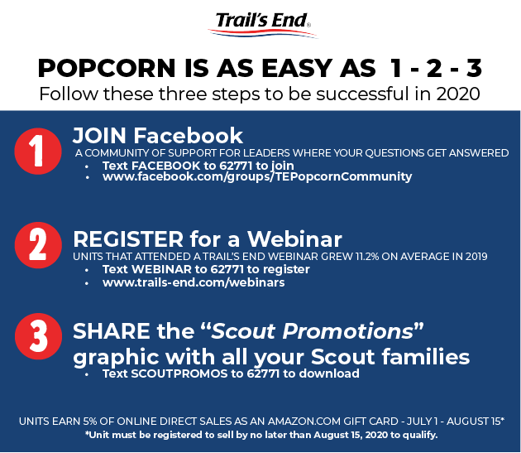
WHAT NOW?
1. JOIN Facebook
2. REGISTER for a Webinar
3. SHARE Scout Promotions graphic to every Scout Family

Slide 32

SHARE w/ ALL Scout Families!!

Slide 33
KEY CONTACTS
Matthew Graham
Matthew.Graham@scouting.org
928-246-9376
Sondra Wendt
sondra@ezinsuranceaz.com
623-297-1475
TE Customer Support
support@trails-end.com

Slide 34

Thank You!

